Slide 1
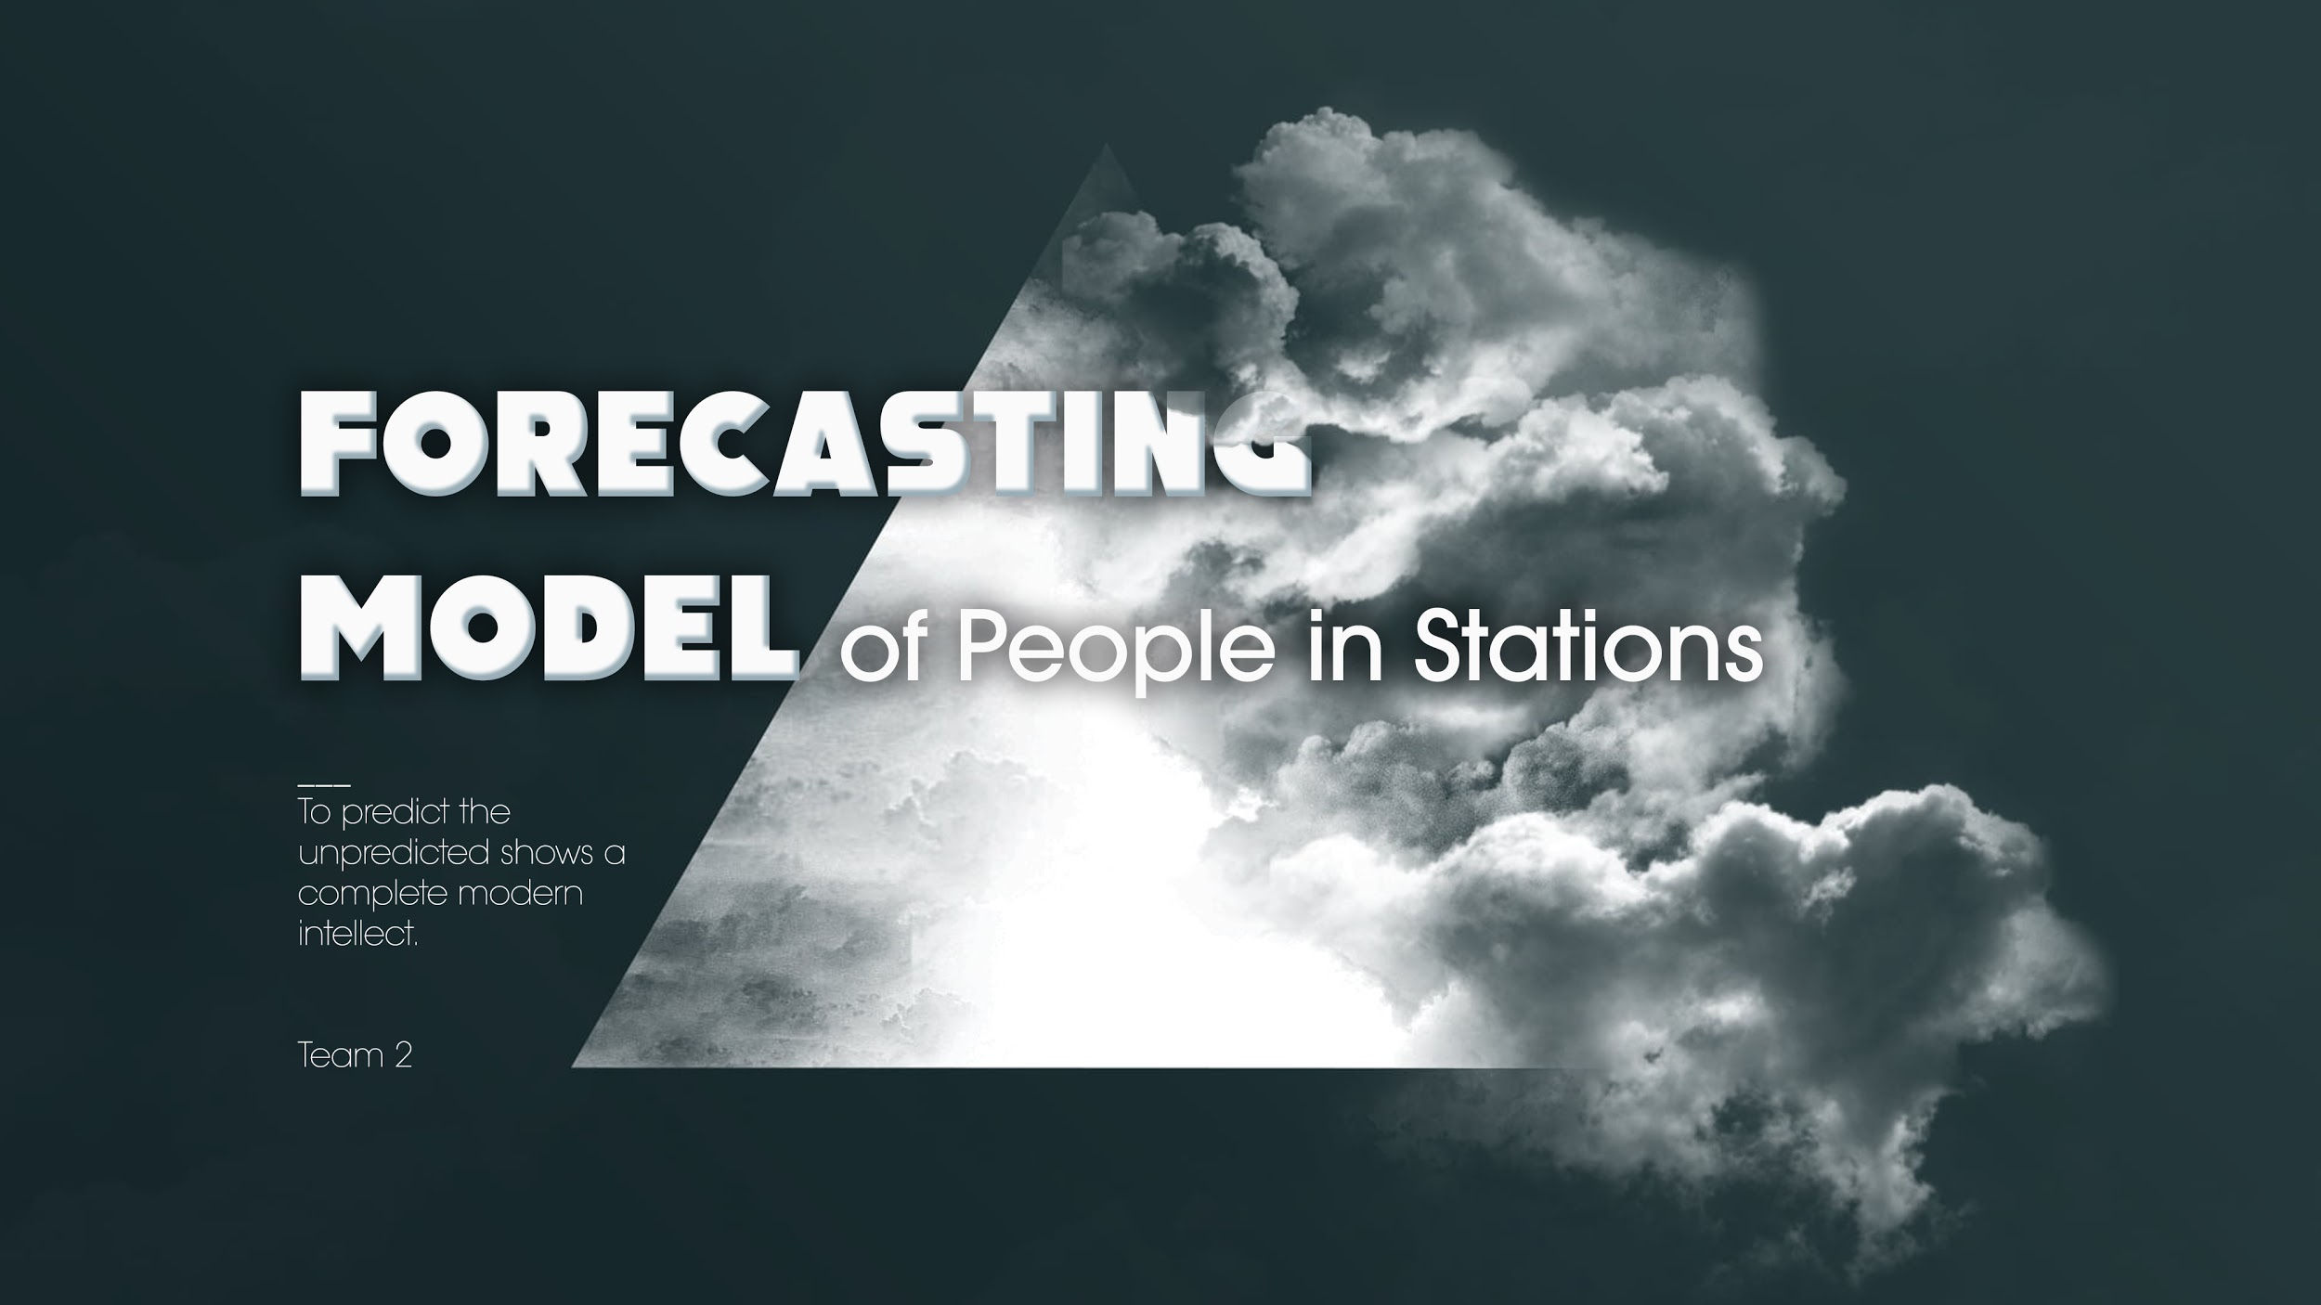

Slide 2

Team 02-09:
Name | Email
Trang Nguyen | tnguy70@ur.rochester.edu
Surya Iyer | siyer9@ur.rochester.edu
Yizhi Lan | ylan5@ur.rochester.edu
Adina Scheinfeld | Adina.Scheinfeld20@bcmail.cuny.edu
Ajinkya Deshmukh | adeshmu2@ur.rochester.edu
Khoi Tran | trankho@mail.gvsu.edu

Slide 3
Background
COVID-19 is a virus which spreads via contact with infected people.
Social distancing is an effective way to keep people safe by preventing the virus from spreading. However, in a metropolitan city such as New York City, proper social distancing guidelines can be difficult to implement.
Our solution enables the maintenance of proper social distancing within the heavily used New York City transportation system.
Our approach relies on identification of the number of people present in a specific station at a given time and the number of people on a specific train at a given time. This data can be used to indicate the safety level of the stations and trains at the specified time.

Slide 4

Objective
Create an application which can help people safely travel via public transportation, in the aftermath of the COVID-19 pandemic.
Create a forecasting model that calculates and predicts the number of people in every train station/train at any given time.

Slide 5
Application
The application will request the following information from the user:
Date of travel
Initial station
Destination station
The application will use the given information to return the following information:
Indicate the safety level of the indicated station/train at the specified time
OR
Forecast the safety of the specified route over the course of the coming week

Slide 6
Data
Train: routes, schedules, status (early/on-time/late), occupancy, capacity
Station: number of people in the station, operational Infrastructure (elevators/escalators)
Tickets: quantity, timestamps (for the forecasting models)
Information from the app: number of searches for a specific station, time, and destination

Slide 7
Models
Forecasting Models (Microsoft Azure Machine Learning) using historical data
Forecast the number of people who will be in a specific station or on a specific train for every hour of the day
Forecast the number of people who will use the transportation system (stations/trains) for the next week
Classification Model (Rule Based/Decision tree)
Classify the usage of the stations and trains (red/orange/green) on the basis of the forecasts, the number of searches for the specific station/train in the app, the fraction of working elevators/escalators at the station, train car occupancy, maximum number of people for system to be considered safe.
A decision tree model can be implemented once sufficient data has been collected.

Slide 8
Architecture

Slide 9
Rules
for a daily view
Number of scans > Safety threshold
Number of scans + number of searches > Safety threshold
Occupancy of all cars RED
Number of scans + number of searches > 0.8 * safety threshold
% Elevators working < 60%
Else

Slide 10
Rules
for a weekly view
Number of search > Safety threshold
Forecast > Safety threshold
Occupancy of all cars RED
Forecast < safety threshold + Number of search > safety threshold
% Elevators working < 60%
Else

Slide 11
Results
We trained a forecasting model to forecast all of the passengers boarding at Grand Central terminal on an hourly basis
The Stack Ensemble model gave the best R-2 score of 0.7580 with an explained variance of 0.75865
We validated the outputs on a single day and the forecasts is close to the actual values
We hope that we could do the same thing for multiple dates and stations but are unable to do so presently due to the lack of time
The model is deployed and the endpoint is given in the document.

Slide 12
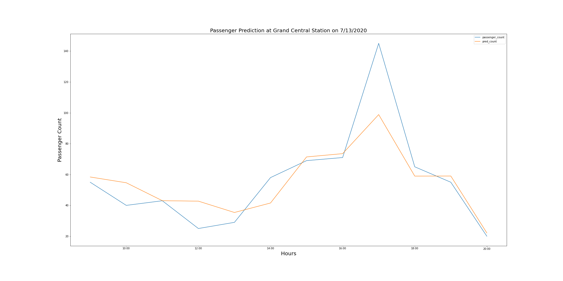
Results

Slide 13

Limitation
Without much prior information, identified weights may not be accurate
Identifying occupancy of each car in a train is difficult

Slide 14
Additional Ideas
Identify busy routes, stations (e.g. GCT), and times (e.g. 7:30 am - 9:00 am).
Usage of visual models to actually count the number of people entering/exiting the station for accuracy.
Using scans taken prior to entry into a train car or post exit from a train car to create a ticketing system which can indicate whether a person is in the train.

Slide 15
GitHub Repo Link
https://github.com/trangun/MTAHackathon

Slide 16
Thank you
Thank you to all the organizers and mentors for arranging the Hackathon and providing support around the clock.
Special thanks to Shaun Mullis, Arathi Natarajan, Priyanshi Singh, and Krina Thakar for all your help!

